Slide 1
Systematic Approaches to Building a Literature Review
Andrew R. Smolski and Shaun Bennet

Slide 2
Getting Started
Pull out a pen and paper. Take a moment, and think about the following question:
What problems have you confronted conducting a literature review?
Then, write down a few of the ideas that come to you. We will share these to start our conversation.

Slide 3
What is a literature review?
Summary and synthesis of extant literature
Can be an article
Criticism
State of the field
More likely a key part of an article
Positioning your paper
Demonstrating novelty

Slide 4
Open Search
What do you do if you don’t have keywords?
Begin with your topic
Use references from articles that best match your topic
Build out a keyword table

Slide 5
Systematic Search
Providing clear parameters for your search
Pick an exact set of keywords
Pick a set of journals that typically publish on your topic
Within discipline
Interdisciplinary
Pick a timeframe to pull articles from
History of the topic
Contemporary state of the topic

Slide 6

Technology for Organizing Literature
Now over to Shaun, who will discuss RefWorks as a tool to help organize the literature you pull.

Slide 7
Example: Environmental Sociology
Topic: Political Economy and the Environment
Keywords: “Ecological modernization”, “treadmill of production”, “treadmill of destruction”, “social metabolism”, “ecological unequal exchange”, “risk society”
Journals: 20 in total, both within discipline and interdisciplinary

Slide 8
Conducting your own literature review, Pt. 1
What keywords are you using? How can you refine your keywords?
What topics do you want to conduct a literature review on?

Slide 9
Strategies for Organizing and Writing a Literature Review
Andrew R. Smolski and Shaun Bennet

Slide 10
Warming Up
Pull out a pen and paper. Take a moment, and think about the following question:
What is your writing process for a literature review?
Then, write down a few of the ideas that come to you. We will share these to start our conversation.

Slide 11
Analyzing and Annotating
Focus on main points
Depending on purpose:
Document theory
Document methods
Document results
Build a coding system

Slide 12
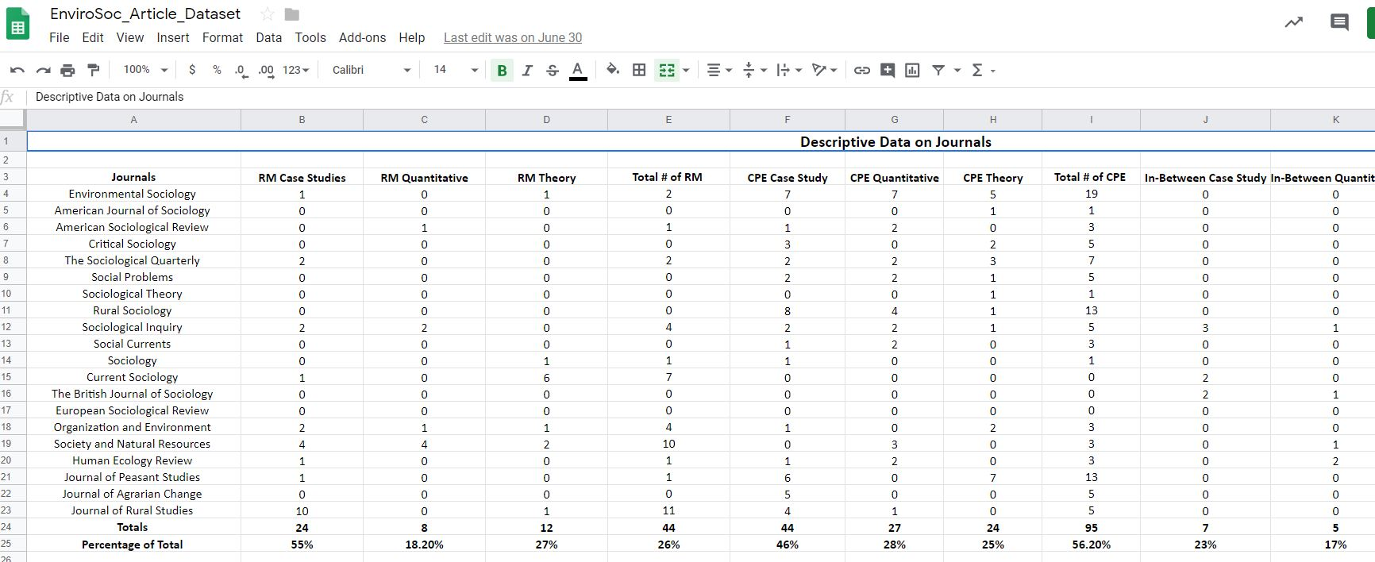
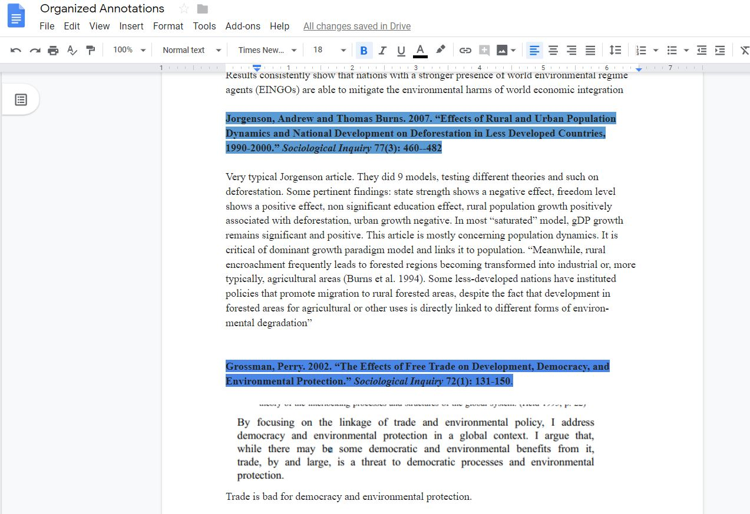
Example: Environmental Sociology
Annotations and Coding: Blue for CPE, Red for RM, Purple for Hybrid

Slide 13
More than Summarization, Synthesis
Summarizing
Represent the author’s argument, not a strawman
Present the main points without oversimplifying
Synthesizing
Fitting parts together to build a cohesive, whole
Novelty of the synthesis

Slide 14

Synthesis and Writing as an Iterative Process
Writing is not a linear process
Instead, writing is back-and-forth

Slide 15
Example: Environmental Sociology
Synthesis: Into theoretical mechanisms, agents/organizations involved, outcomes
Frameworks | Mechanisms | Outcomes
Reflexive Modernity | Technological Innovation Commodification (+) Institutional Reflexivity | Reducing Ecological Risk Risk Universalization
Critical Political Economy | Techno-Fix Commodification (-) Anti-Reflexivity | Increasing Ecological Risk Risk Stratification

Slide 16

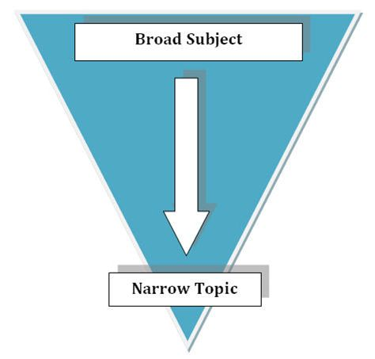
Strategies for Writing
Narrow to a manageable piece
Reverse Outline

Slide 17
Conducting your own literature review, Pt. 2
What general trend from your search could you organize your literature review around?
What is the big question your literature review is based upon? What is the narrower focus?
What is your ideal for your project? What pragmatic considerations should you account for?

